Slide 1
Operating System [ 4th-Semester]

Slide 2
Chapter 1. Introduction
2

Slide 3
Topics Covered
What is an operating system
views of operating system
The history of Operating System
Evolution of Operating System
3

Slide 4
Introduction
A modern computer consists of :
One or more processors ,Main memory ,Disks , Printers, Various input/output devices
Managing all these components requires a layer of software – the operating system
It is impossible for every application programmer to understand every detail.
A layer of computer software is introduced to provide a better, simpler, cleaner model of the resources and manage them.
4

Slide 5
What is an Operating System?
An OS is a system program that controls the execution of application programs and acts as an interface between applications and the computer hardware.
The operating system acts as a resources manager and allocates them to specific programs and users, whenever necessary to perform a particular task. Therefore operating system is the resource manager.
A computer system has many resources (hardware and software), which may be require to complete a task. The commonly required resources are input/output devices, memory, file storage space, CPU etc.
5

Slide 6
It can be thought of as having three objectives:
Convenience : An OS makes a computer more convenient to use.
Efficiency: An OS allows the computer system resources to be used in an efficient manner.
Ability to evolve: An OS should be constructed in such a way as to permit the effective development, testing, and introduction of new system functions without interfering with service.
Most computers have two modes of operation:
Kernel mode and user mode

Slide 7
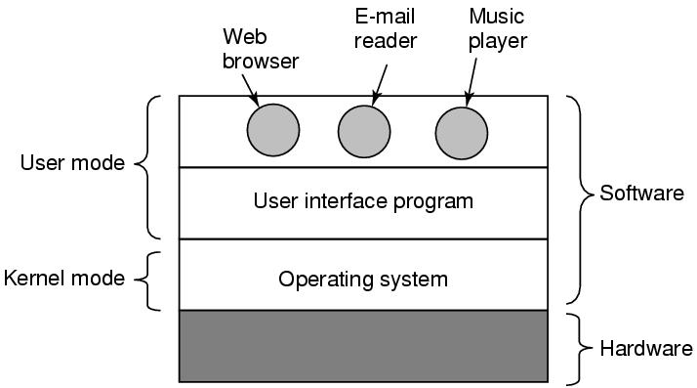
OS runs in kernel mode, which has complete access to all hardware and can execute any instruction Rest of software runs in user mode, which has limited capability Shell or GUI is the lowest level of user mode software
Figure :Where the operating system fits in.

Slide 8
Computer System Components
Computer system can be divided into four components
Hardware:
Provides basic computing resources (CPU, memory, I/O devices).
Operating System :
Controls and coordinates the use of hardware among application programs.
Application Programs :
Solve computing problems of users (compilers, database systems, video games, business programs such as banking software).
Users : People, machines, other computers
8

Slide 9
Two functions:
From top to down: provide application programmers a clean abstract set of resources instead of hardware ones
From down to top: Manage these hardware resources

Slide 10
The Operating System as a Resource Manager
Allow multiple programs to run at the same time
Manage and protect memory, I/O devices, and other resources
Includes multiplexing (sharing) resources in two different ways:
In time
In space
Modern OS runs multiple programs of multiple users at the same time
Imagine what would happen if several programs want to print at the same time?
How to account the resource usage of each process?
Resources can be multiplexed:
How to ensure fairness and efficiency?

Slide 11
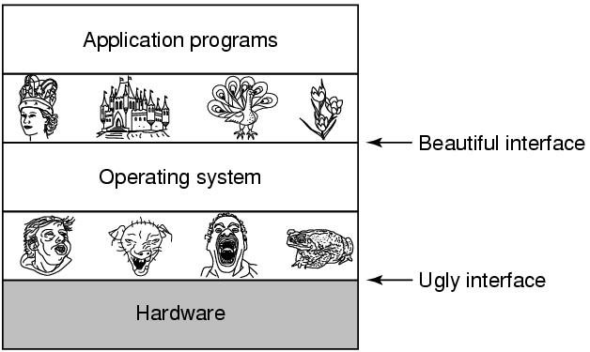
The Operating System as an Extended Machine
Figure : Operating systems turn ugly hardware into beautiful abstractions

Slide 12
Abstraction:
CPU—process
Storage –- files
Memory– address space
4 types of people:
Industrial engineer: design hardware
Kernel designer
Application programmer: OS’s user
End users

Slide 13
Two Views of Operating System
User View
The goal of the Operating System is to maximize the work and minimize the effort of the user.
Most of the systems are designed to be operated by single user, however in some systems multiple users can share resources, memory. In these cases Operating System is designed to handle available resources among multiple users and CPU efficiently.
Operating System must be designed by taking both usability and efficient resource utilization into view.
In embedded systems(Automated systems) user view is not present.
There are some devices that contain very less or no user view because there is no interaction with the users. Examples are embedded computers in home devices, automobiles etc.
13

Slide 14
Two Views of Operating System
System View
From the system point of view Operating System is a program involved with the hardware.
Operating System is allocator, which allocate memory, resources among various processes. It controls the sharing of resources among programs.
It prevents improper usage, error and handle deadlock conditions.
It is a program that runs all the time in the system in the form of Kernel.
It controls application programs that are not part of Kernel.

Slide 15
Operating System functions
Process management:- Process management helps OS to create and delete processes. It also provides mechanisms for synchronization and communication among processes.
Memory management Memory management module performs the task of allocation and de-allocation of memory space to programs in need of this resources.
Device management Device management keeps tracks of all devices. This module also responsible for this task is known as the I/O controller
I/O System Management: One of the main objects of any OS is to hide the peculiarities of that hardware devices from the user.
Graphics User Interface (GUI) management: Provides and manages the user interface that interacts with graphics and visual content on a computing device.

Slide 16
Continue..
Secondary-Storage management which includes primary storage, secondary storage, and cache storage.
Application which allows standard communication between software and your computer.
User interface which allows you to communicate with your computer.
Job accounting: Keeping track of time & resource used by various job and users.
Networking: The processors communicate with one another through the network.
Security module protects the data and information of a computer system against malware threat and authorized access.
Error

Slide 17
History of Operating Systems
Generations:
(1945–55) Vacuum Tubes
(1955–65) Transistors and Batch Systems
(1965–1980) ICs and Multiprogramming
(1980–Present) Personal Computers
(1990-present) Mobile Computers

Slide 18
1st: vacuum tubes
Large and slow
Engineers design, build, operate and maintain the computer
All programming is done with machine language, or by wiring circuits using cables
insert plugboards into the computer and operate
The work is mainly numerical calculations

Slide 19
2nd: transistors and batch systems
Also called mainframes
Computers are managed by professional operators
To run a job (i.e., a program or set of programs), a programmer would first write the program on paper (in FORTRAN or assembler),then punch it on cards.
Collect a batch of jobs in the input room, then read them into a magnetic tape; the same for output
Assembly language and high-level programming languages like FORTRAN, COBOL were used.

Slide 20
3rd: IC and Multiprogramming
OS/360:
Aims to adapts 1401/7904, covers all trades of life
However, OS/360 introduces several key techniques
Multi-programming: solve the problem of CPU idling
Spooling: simultaneous peripheral operation on line
Whenever a job finishes, OS load a new job from disk to the empty-partition
High-level languages (FORTRAN-II TO IV, COBOL, PASCAL PL/1, BASIC, ALGOL-68 etc.)

Slide 21
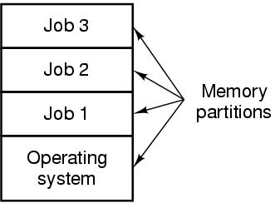
3rd: ICs and Multiprogramming
Figure . A multiprogramming system with three jobs in memory.

Slide 22
3rd: Ics and Multiprogramming
Problems:
3rd generation OS was well suited for big scientific calculations and massive data processing
But many programmers complain a lot… for not be able to debug quickly…. Why?
And the solution to this problem would be….?
Timesharing

Slide 23
4th: personal computers
Computers of fourth generation used Very Large Scale Integrated (VLSI) circuits
CP/M(Control Program for Microcomputers)
First disk-based OS
1980, IBM PC, Basic Interpreter, DOS, MS-DOS
GUI--Lisa—Apple: user friendly (UNIX)
MS-DOS with GUI– Win95/98/me(Millennium Edition)—winNT
Time sharing, real time networks, distributed operating system were used.

Slide 24
^{5th}: Mobile Computers
VLSI technology became ULSI (Ultra Large Scale Integration) technology, resulting in the production of microprocessor chips having ten million electronic components.
The first real smartphone did not appear until the mid-1990s when Nokia released the N9000: a phone and a PDA (Personal Digital Assistant).
Symbian OS popular brands like Samsung, Sony Ericsson, Motorola, and especially Nokia.
Other operating systems like RIM’s Blackberry OS (introduced for smartphones in 2002) and Apple’s iOS (released for the first iPhone in 2007)
Linux-based operating system released by Google in 2008

Slide 25
Evolution of the Operating System
Serial Processing:
It develops by 1940 to 1950’s the programmer interacted directly with the computer hardware; there was no OS.
The problems here are the scheduling and setup time.
Scheduling: A user might sign up for an hour and finish in 45 minutes; this would result in wasted computer processing time On the other hand, the user might run into problems, not finish in the allotted time, and be forced to stop before resolving the problem.
Setup time: A single program called a job had to be installed before used with its compiler and code, saving the object program and linking and so on to run the program.

Slide 26
Simple Batch Systems:
To improve utilization, the concept of a batch OS was developed. It appears that the first batch OS was developed in the mid-1950s.
The central idea behind the simple batch-processing scheme is the use of a piece of software known as the monitor .
The monitor is always in the main memory and available for execution.
In this type of system, there is no direct interaction between user and the computer.
Instead, the user submits the job on cards or tape to a computer operator, who batches the jobs together sequentially and places the entire batch on an input device.
Then a special program, the monitor, manages the execution of each program in the batch.

Slide 27
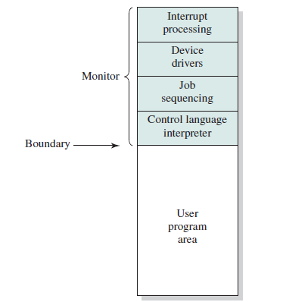
Resident Monitor is software always in memory
Monitor reads in job and gives control
Job returns control to monitor
Figure :Memory Layout for a Resident Monitor
Multiprogrammed Batch Systems:
The I/O devices are much slower than the processor, leaving the processor idle most of the time waiting for the I/O devices to finish their operations.

Slide 28
It is used to have several jobs to execute which should be held in main memory. If several jobs are ready to run at the same time, then the system chooses which one to run through the process of CPU Scheduling.
In Multiprogramming system, CPU will never be idle and keeps on processing.
In Uniprogramming only one program sits in the main memory so it has a small size. But in the case of multiprogramming main memory needs more space.
Uniprogramming system runs smoothly as only one task is run at a time. The slow processor can also work well in Uniprogramming but in multiprogramming processor needs to be fast. In multiprogramming large space of RAM is needed.
Fixed-size partition is used in Uniprogramming. Both fixed and variable size partitions can be used in multiprogramming systems.

Slide 29
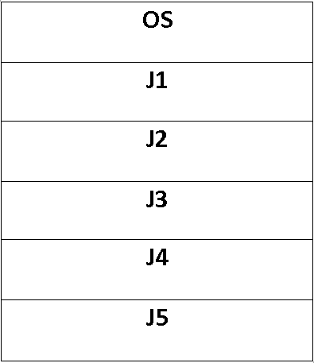
Example of Uniprogramming
Batch processing in old computers and
mobiles
The old operating system of computers
Old mobile operating system
Example of Multiprogramming
Modern operating systems like Windows
XP and Windows 7,8,10
The main memory consisting 5 jobs at a time ,the CPU execute one by one.

Slide 30
Time-Sharing Systems :
As multiprogramming allows processor to handle multiple batch jobs at time, it can allow the processor to handle multiple interactive jobs at time, through time sharing.
Time Slicing/quantum: there is a system clock that generates interrupts at a constant rate, allowing the OS regain control and assign the processor to another process.
The time sharing system provides the direct access to a large number of users where CPU time is divided among all the users on scheduled basis
Time Sharing' is no longer commonly used, it has been replaced by 'Multitasking System’ also known as multitasking.

Slide 31
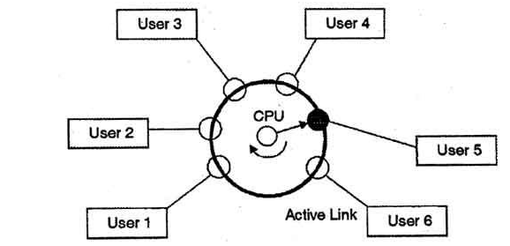
In above figure the user 5 is active but user 1, user 2, user 3, and user 4 are in waiting state whereas user 6 is in ready status.
As soon as the time slice of user 5 is completed, the control moves on to the next ready user i.e. user 6. In this state user 2, user 3, user 4, and user 5 are in waiting state and user 1 is in ready state. The process continues in the same way and so on.

Slide 32
Other types of Operating systems
Real-time operating system (RTOS):
It is defined as an operating system known to give maximum time for each of the critical operations that it performs, like OS calls and interrupt handling.
Real-time systems are used when there are rigid time requirements on the operation of a processor or the flow of data and real-time systems can be used as a control device in a dedicated application.
The Real-Time Operating system which guarantees the maximum time for critical operations and complete them on time are referred to as Hard Real-Time Operating Systems.
32

Slide 33
Eg. Air traffic control systems, missile, and nuclear reactor control systems etc.
A soft real time system is a system in which one or more failures to meet the deadline is not considered as complete system failure but that performance is considered to be degraded. These systems are referred to as Soft Real-Time Operating Systems.
Eg. Multimedia streaming, advanced scientific projects, and virtual reality etc.
33

Slide 34
Network operating System(NOS):
A network operating system is a specialized operating system for a network device such as a router, switch or firewall.
NOS allows the protection of data, information, and their hardware components from unauthorized users.
It provides the remote access to server/client machines.
Eg. Microsoft Windows Server 2003, Microsoft Windows Server 2008, UNIX, Linux, Mac OS X, Novell NetWare, and (Berkeley Software Distribution)BSD.
34

Slide 35
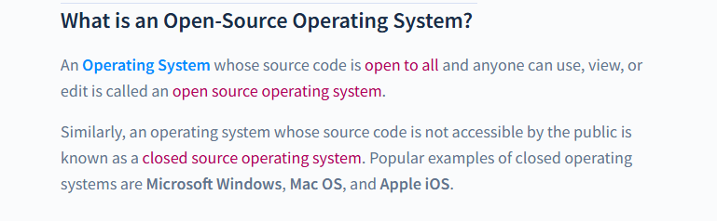
Open Source Operating System
An Open Source Operating System is an operating system whose copyright holders or owners enable the third parties or the user to use, see, and edit the operating system's source code. We can create an operating system according to our requirements by altering the source code of an open-source operating system.

Slide 36
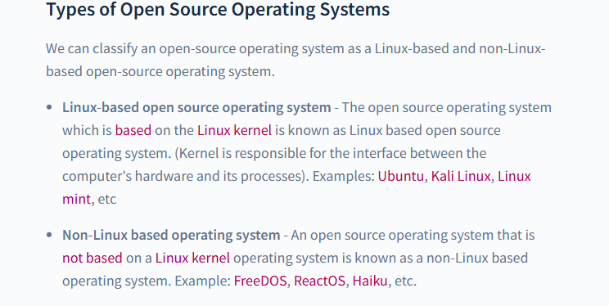

Slide 37
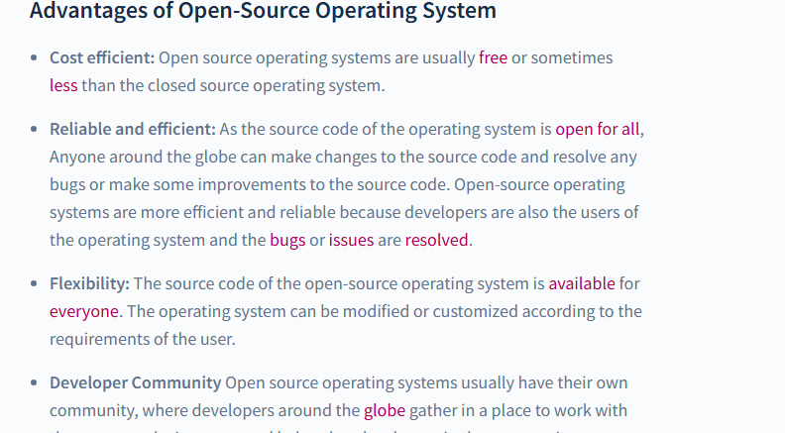

Slide 38
Thank You
38

